Slide 1

Password Gorilla
A password manager coded in Tcl/Tk
Notes:
Goal:
To show how easy it is to develop a multiplatform, multi-language GUI application.

Slide 2

Part 1: Application related aspects
Features
Screenshots & Demonstration
Taking over the project „Password Gorilla“
Maintaining the sources
Development tools
Getting Feedback
Notes:
Motivation weglassen
Linux ist Basissystem

Slide 3
Part 2: Tcl/Tk related aspects
Creating executables
Managing the OSX port
Speeding up the encryption algorithms
The Hypertext Help System
Localisation with GNU's gettext utility
Testing with tcltest
Documentation with Ruff
Preview: The Android port
Notes:
Motivation weglassen
Linux ist Basissystem

Slide 4
Features
Cross-platform password manager
Copy-paste service
Integrated random password generator
Cross-platform: Linux, FreeBSD, Windows and MacOS X
Compatibility to actual Password Safe 3.2 databases
SHA256 protection for the master password
Content encryption with Bruce Schneier’s Twofish algorithm
Prevention of brute force attacks by key stretching.
Integration of a hypertext help system
Localization support
Starpack versions for Linux, Windows, OSX
Dependency for use with sources: Tk 8.5
Notes:
Motivation weglassen
Linux ist Basissystem
1.47 itcl bwidget
1.50 ttk treeview, msgcat, Tk 8.5
Tcltest
Ruff documentation system

Slide 5
Part 1: Application related aspects

Slide 6
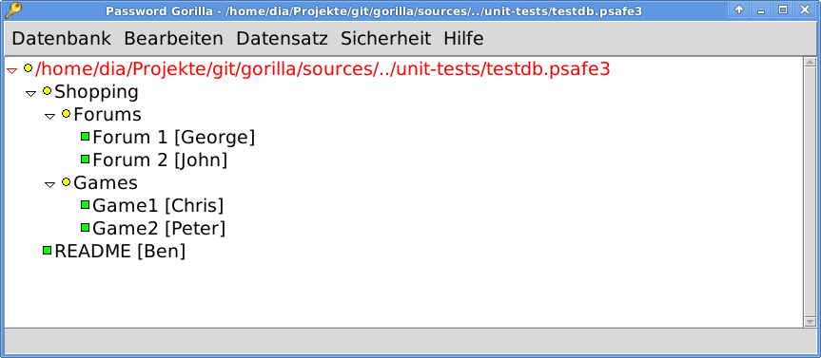
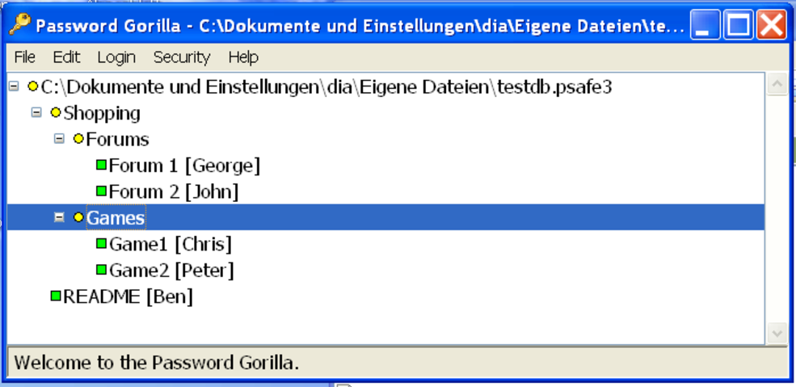
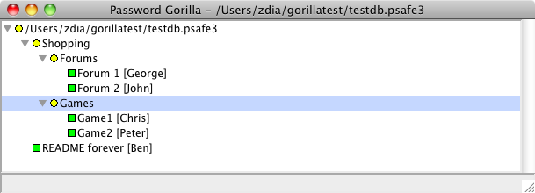
Password Gorilla: Linux Version
Main screen

Slide 7
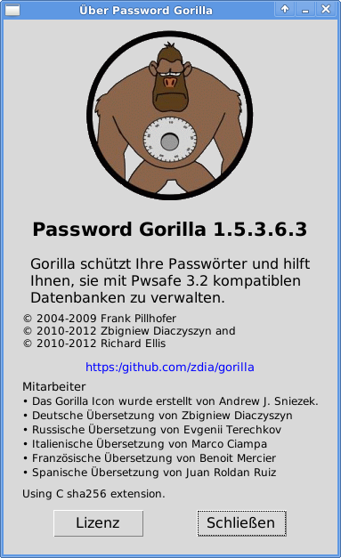
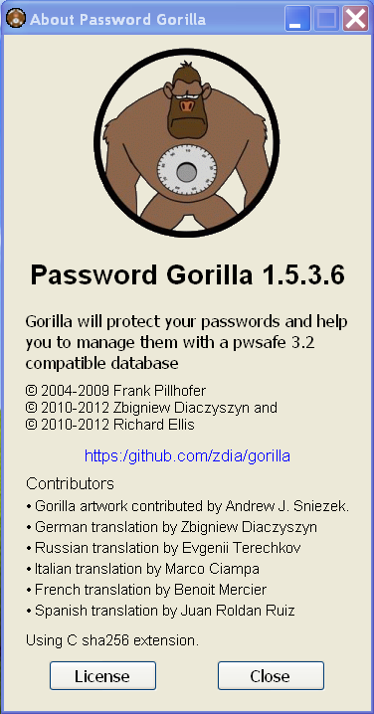

Slide 8

Taking over the project
Frank Pillhofer (2004-2009)
  Version 1.4.7
  Itcl, Bwidget
Zbigniew Diaczyszyn (2010)
  Version 1.5.x
  Bwidget replaced by Ttk widgets
  msgcat mechanism added
  Translation into German language
Richard Ellis (2010)
  Improving constantly code, adding various modules

Slide 9
Maintaining the sources
Git
  Encourages cloning
  Fully fledged local repository
  Simple and effective local branches
  GUI programs: gitk, „git gui“
Github Server
  Download area
  Wiki (Textile)
  Automatic code tarballs
  Social coding
  Issue management
Notes:
9000 Zeilen

Slide 10
Development Tools
Texteditor Geany
  Syntax highlighting (Tcl/Tk)
  Code folding
  Symbol name auto-completion
  Construct completion/snippets
  Symbol lists (for code navigation)
  Simple project management
  Plugin interface (see Plugins)
Tkcon
  Console access to live running PWGorilla process
  Edit command to inspect/change procedures or variables
  Source and change the running system in real time

Slide 11

Getting feedback
Editor's Opinion
Password Gorilla - a powerful and highly efficient way in which you can securely store all of your login credentials. This versatile and easy to use piece of software is an excellent tool for any computer user that wants to secure all of their accounts.

Slide 12
Part 2: Tcl/Tk related aspects
Notes:
Motivation weglassen
Linux ist Basissystem

Slide 13
Creating executables (1)
Virtual Filesystem gorilla.vfs
gorilla.vfs/
|-- lib/
| `-- app-gorilla/
|-- main.tcl
`-- tclkit.ico*
app-gorilla/ is linked to:
/home/dia/Projekte/git/gorilla/sources/

Slide 14
Creating executables (2)
Content of main.tcl
package require starkit
starkit::startup
package require app-gorilla 1.0
First line in application:
package provide app-gorilla 1.0

Slide 15
Creating executables (3)
Final creation command:
./tclkit sdx.kit wrap gorilla.exe -runtime <path/tclkit-version>
Actual runtime versions:
tclkit-8.5.11-tk-freebsd-ix86
tclkit-8.5.11-linux
tclkit-tk-8.5.11-linux-x86_64
tclkit-8.5.11-win32.exe
tclkit-tk-8.5.11-win32-x86_64
tclkit-8.5.11-macosx-universal

Slide 16
The OSX port : Bundle Structure
The application bundle gorilla.zip
|-- Password Gorilla.app
| `-- Contents
| |-- Info.plist
| |-- MacOS
| | `-- gorilla.aqua
| `-- Resources
| `-- Gorilla.icns
`-- gorilla.zip

Slide 17
The OSX port: The OSX Menus
If { [tk windowingsystem] == "aqua"} {
# we have to delete the psn_nr in argv
if {[string first "-psn" [lindex $argv 0]] == 0} {
set argv [lrange $argv 1 end]}
}
proc ::tk::mac::ShowPreferences {} {
gorilla::PreferencesDialog
}
proc ::tk::mac::Quit {} {
gorilla::Exit
}
proc tk::mac::ShowHelp {} {
gorilla::Help
}
}

Slide 18
The OSX port: The About Dialog
Enable the event:
proc tkAboutDialog {} {
gorilla::About
}
Manage the menu entry:
menu .mbar.apple
.mbar add cascade -menu .mbar.apple
.mbar.apple add command -label "[mc "About"] Password Gorilla" \
-command gorilla::About

Slide 19
The OSX port: The File Dialog
Native fileselect dialog does not allow filtering of files:
tk_getOpenFile -filetypes [list ] -initialdir $::gorilla::dirName

Slide 20
C Extensions with CriTcl
Get CriTcl version 3 (Compiled Runtime In Tcl):
$ git clone https://github.com/jcw/critcl.git
Build critcl starpack:
$ ./build.tcl starpack prefix ?destination?
Use it to build extension package sha256c:
$ critcl -pkg sha256c.tcl
Get help:
https://github.com/jcw/critcl/blob/master/embedded/www/toc.html

Slide 21
Directory structure for CriTcl created libraries:
sha256c/
|-- freebsd-ix86/
| `-- sha256c.so*
|-- linux-ix86/
| `-- sha256c.so*
|-- linux-x86_64/
| `-- sha256c.so*
|-- macosx-ix86/
| `-- sha256c.dylib*
|-- macosx-x86_64/
| `-- sha256c.dylib*
|-- win32-ix86/
| `-- sha256c.dll*
|-- win32-x86_64/
| `-- sha256c.dll*
|-- critcl.tcl
`-- pkgIndex.tcl

Slide 22
C Extensions with CriTcl
Build and use on native system
Intensiv testen cross-compile → Windows
$ critcl -pkg -target mingw32 foo
linux-32-*
linux-64-*
macosx-universal
mingw32
win32-ix86-cl
win32-x86_64-cl-buf
win32-x86_64-cl-nobuf

Slide 23
Help system features
A help system originally based on Tcl Wiki 1194 and Tile
Author: Keith Vetter (May 2007)
Hyperlinks to other help pages
Simple searching ability
History
Simple wiki formatting:
  Nested numeric, bullet and dash lists
  Bold, italic and unformatted text
Table of Contents
Adapted for PWGorilla with msgcat support and Ttk widgets

Slide 24
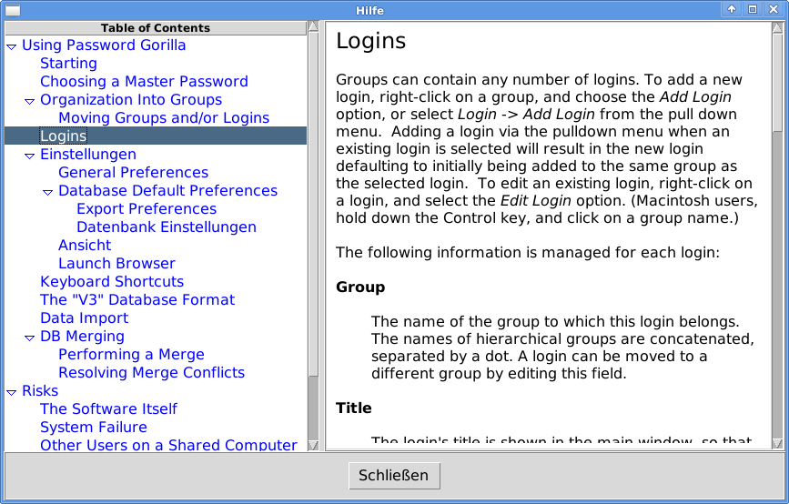
The Hypertext Help System

Slide 25
Help system text example
-------------------
title: Logins
Groups can contain any number of logins. To add a new login, right-click on a group, and choose the ''Add Login'' option, or select ''Login'' -> ''Add Login'' from the pull down menu. [...]
The following information is managed for each login:
'''Group'''
| The name of the group to which this login belongs. The names of
hierarchical groups are concatenated, separated by a dot. A login can be moved to a different group by editing this field.

Slide 26
Modifying The Help System
It is based on a treeview and a text widget
Example for adding an indented paragraph with sign „|“:
  $w.t tag config bar -lmargin1 $l2 -lmargin2 $l2
  ...
  if { $op1 eq "|" } { ; # Bar
set tag bar
}

Slide 27
Using The Help System
source viewhelp.tcl
proc gorilla::Help {} {
  # ReadHelpFiles is looking in the given directory
  # for a file named help.txt
  ::Help::ReadHelpFiles $::gorillaDir $::gorilla::preference(lang)
  ::Help::Help Overview
}

Slide 28
Localization with gettext
Source code format:
puts [ mc "Need %s" $file ]
Create a Portable Object Template:
xgettext -kmc -o gorilla.pot -L Tcl gorilla.tcl ?...?
Result in file gorilla.pot:
#: ../../sources/gorilla.tcl:193
#, tcl-format
msgid "Need %s"
Msgstr ""

Slide 29
Gettext: Creating locale .po file
Create English version en.po:
Msgen -o en.po gorilla.pot
Edit gorilla.pot:
#: ../../sources/gorilla.tcl:193
#, tcl-format
msgid "Need %s"
msgstr ""
Save result in file de.po:
#: ../../sources/gorilla.tcl:193
#, tcl-format
msgid "Need %s"
msgstr "Benötige %s"

Slide 30
Gettext: Updating .po files
Merge existing <lang>.po with new gorilla.pot:
msgmerge --update <lang>.po --backup=simple gorilla.pot"
Create a Tcl *.msg language file:
msgfmt --tcl -l<lang> -d <path-to-msgs-dir> <lang>.po
(lang = en, de, fr, ru ...)
Result in file de.msg:
::msgcat::mcset de "Need %s" "Ben\u00f6tige %s"
::msgcat::mcset de "File" "Datenbank"
...

Slide 31
Gettext: Tweaking .msg files
Redefine mcset:
proc mcset { lang fromstr tostr } {
variable msgdata
dict lappend msgdata $lang $fromstr $tostr
}
Use the created dictionary to build the final de.msg:
mcmset de {
{Need %s} {Benötige %s}
File Datenbank
...
}

Slide 32
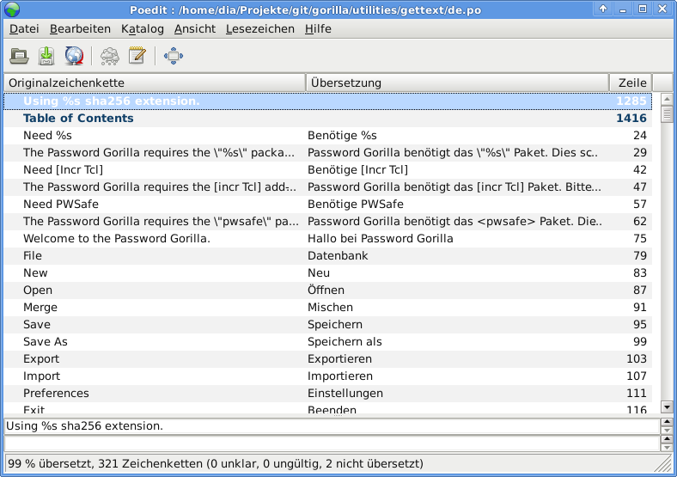
Gettext: Editor poedit

Slide 33
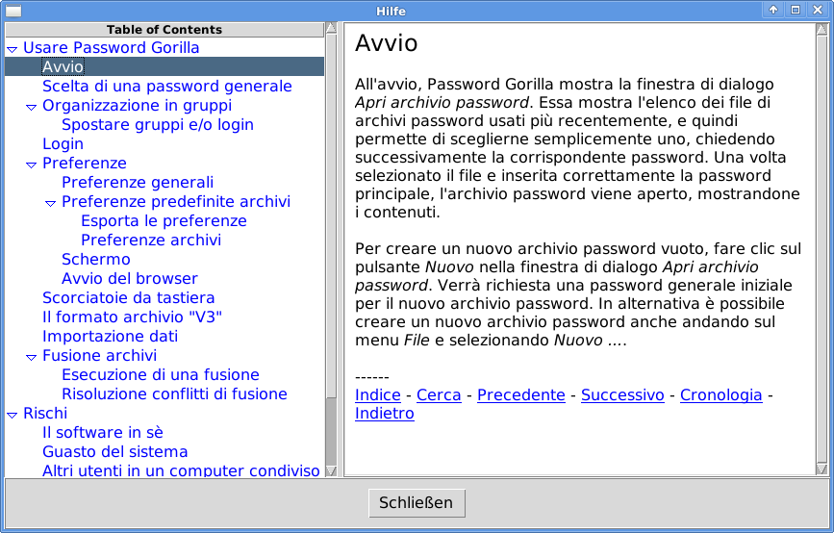
Gettext: Italian Help Text

Slide 34
Documentation Generator Ruff!:
Ruff! (Runtime function formatter) v0.4
Author: (c) Ashok P. Nadkarni
http://woof.magicsplat.com/ruff_home
Written in Tcl
Generation by runtime introspection
Comment analysis

Slide 35
Ruff!: Use
Initialization:
Package require ruff struct::list
set nslist [ ::struct::list filterfor z [ namespace children :: ] \
{ ! [ regexp {^::(ttk|uuid|msgcat|pkg|tcl|auto_mkindex_parser|itcl|sha2|tk|struct|ruff|textutil|cmdline|critcl|activestate|platform)$} $z ] } ]
::ruff::document_namespaces html $nslist -output gorilladoc.html -recurse true
Gorilla --sourcedoc

Slide 36
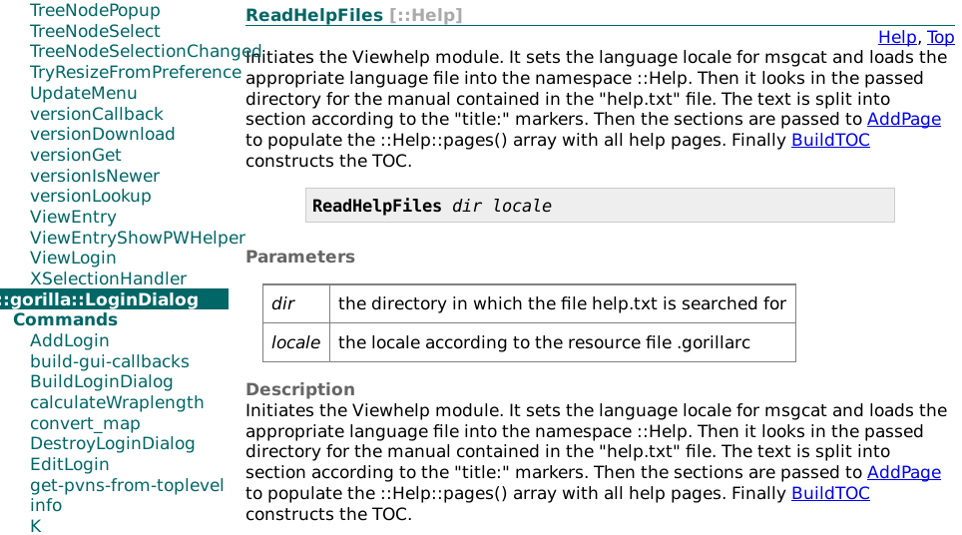
Ruff!: Html Output

Slide 37
Tcltest: source code integration
Switch of commandline option:
--tcltest {
# TCLTEST 1 and TEST 1 means:
# skip the OpenDatabase dialog and load testdb.psafe3
array set ::DEBUG { TCLTEST 1 TEST 1 }
  }
After general and GUI initialization:
if { $::DEBUG(TCLTEST) } {
set argv ""
source [file join $::gorillaDir .. unit-tests RunAllTests.tcl]
}
Notes:
Gui waiting for user click in dialogs, menus
How to test it?
Omit them. Control with DEBUG array

Slide 38
Tcltest: Directory structure
unit-tests
|-- RunAllTests.tcl
|-- backup
| `-- backup.test
|-- csv-export
| |-- csv-export.test
| `-- normexport.csv
|-- csv-import
| |-- csv-import.test
| |-- import11.csv
| |-- import110.csv
| |-- import17.csv
|-- lock-database
| `-- lock.test
`-- testdb.psafe3
Notes:
Gui waiting for user click in dialogs, menus
How to test it?
Omit them. Control with DEBUG array

Slide 39
Tcltest: RunAllTests.tcl
package require tcltest 2.2
...
# default search path is the actual working directory
tcltest::workingDirectory [file dirname [file normalize [info script]]]
tcltest::singleProcess 1 ;# caller environment will be used
tcltest::verbose { pass }
...
foreach testFile $testList {
source $testFile
}
...
tcltest::cleanupTests ;# will give the results and exit
Notes:
Gui waiting for user click in dialogs, menus
How to test it?
Omit them. Control with DEBUG array

Slide 40
Tcltest: A Single Test
test $testname-1.2 {File Open Error} \
-setup { set ::DEBUG(CSVIMPORT) 1 } \
-body { gorilla::Import unknown.csv } \
-cleanup { set ::DEBUG(CSVIMPORT) 0 } \
-result GORILLA_OPENERROR
Notes:
Gui waiting for user click in dialogs, menus
How to test it?
Omit them. Control with DEBUG array

Slide 41
Tcltest: Final Test Run
$ gorilla --tcltest
++++ csv-import.test-1.2 PASSED
++++ csv-import.test-1.3 PASSED
++++ csv-import.test-1.4 PASSED
...
++++ csv-import.test-1.13 PASSED
++++ csv-import.test-1.1 PASSED
++++ csv-import.test-2.1 PASSED
++++ csv-import.test-2.2 PASSED
++++ csv-import.test-2.3 PASSED
++++ csv-export.test-1.0 PASSED
++++ lock-database-1.1 PASSED
++++ backup-1.1 PASSED
++++ backup-1.2 PASSED
RunAllTests.tcl: Total 20 Passed 20 Skipped 0 Failed 0
Notes:
Gui waiting for user click in dialogs, menus
How to test it?
Omit them. Control with DEBUG array

Slide 42
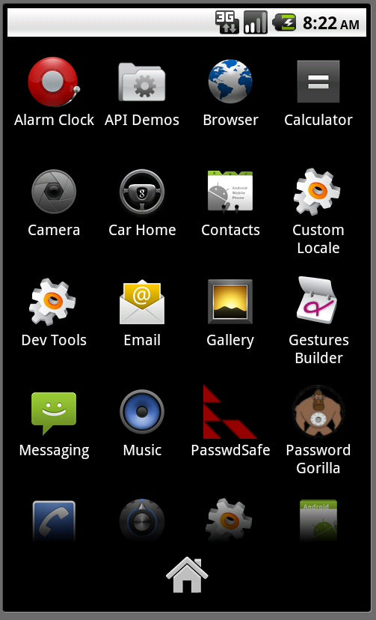
Android: Launch

Slide 43
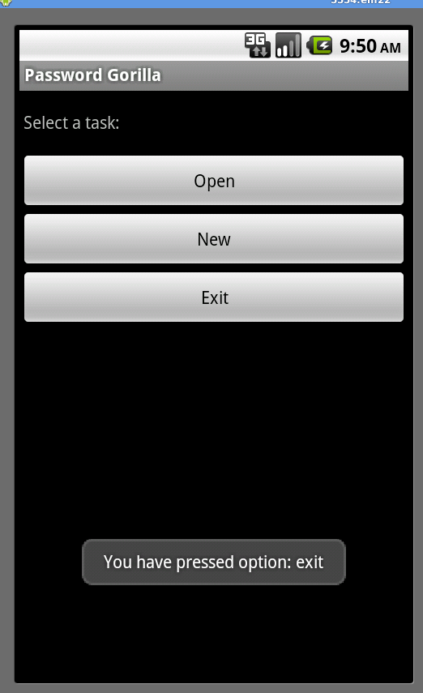
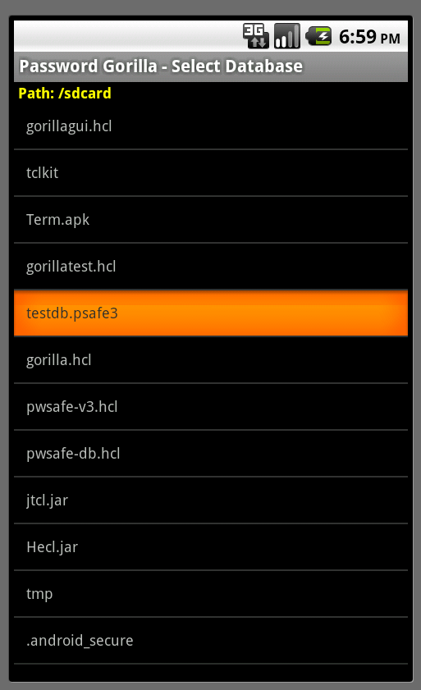
Android: OpenDialog and FileDialog

Slide 44
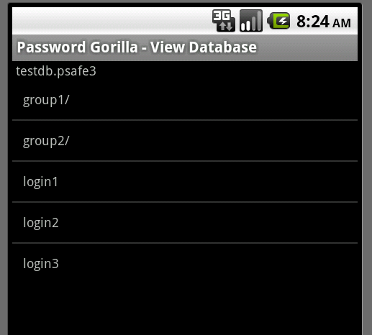
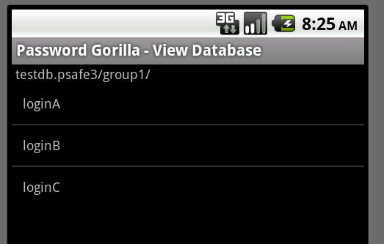
Android: Content Listing

Slide 45
Hecl: Tcl-like Syntax
Math operations in Polish notation:
puts "2 + 2 = [+ 2 2]"
if { < $temp 0 } { puts "It's freezing" }
Command hash (instead of array or dict)
set foo [hash {a b c d}]
puts [hget $foo a] ;# prints 'b'
hset $foo c 2
puts [hget $foo c] ;# prints '2'
puts $foo
# prints 'a b c 2' (although not necessarily in that order)

Slide 46
Hecl: Add new command hello
Define it in source file HelloCmd.java:
import org.hecl.Command;
import org.hecl.HeclException;
import org.hecl.Interp;
import org.hecl.Thing;
class HelloCmd implements Command {
public Thing cmdCode(Interp interp, Thing[] argv) throws HeclException {
System.out.println("Hello world");
return null;
}
}
Include the following line in commandline/Hecl.java:
interp.addCommand("hello", new HelloCmd());

Slide 47
Hecl: GUI example
set context [activity]
set layout [linearlayout -new $context]
$layout setorientation VERTICAL
set layoutparams [linearlayoutparams -new { \
FILL_PARENT WRAP_CONTENT}]
set tv [textview -new $context -text {Hello World} \
-layoutparams $layoutparams]
$layout addview $tv
[activity] setcontentview $layout

Slide 48
Hecl: The command java
Implement new commands with command java:
hecl> java java.lang.Integer integer
Integer
Use the object's methods:
# System.out.println( Integer.toHexString(2048) );
hecl> set hex [integer toHexString 2048]
800
# int decimalNumber = Integer.parseInt(800, 16);
hecl> integer parseInt "800" 16
2048

